Slide 1

CRM Aplan FOR work planning and STAFF Management
Current Work Status Storage
Workflow Designer
Workflow Participant Diary
For Service Enterprises
Fast and easy with intuitive interface
Multilingual, multi-currency
Adjustable access rights

Slide 2
PLACEMENT AND FUNCTIONALITY
Own server or leased cloud, access to them from any device
Operative and final reports in PDF, XLSX formats
Statistics collection
of clients and workers
PLACEMENT
REPORTS AND NOTIFICATIONS
STATISTICS AND EVALUATION
A single repository of documents and media attached to each job
Nnotifications for workflow participants
Performance indicators: scope of work, KPI, etc.

Slide 3
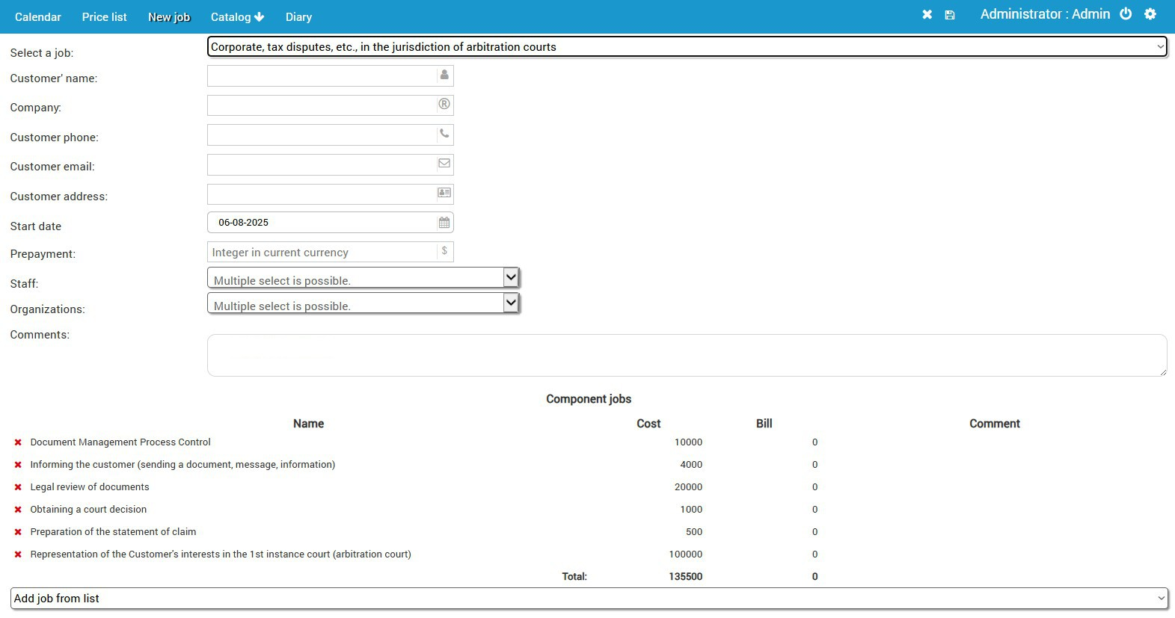
CONSTRUCTION and Work Planning
Each work is designed from a set of tasks
Each task can have financial and time parameters
Each task is associated with workers and organizations

Slide 4
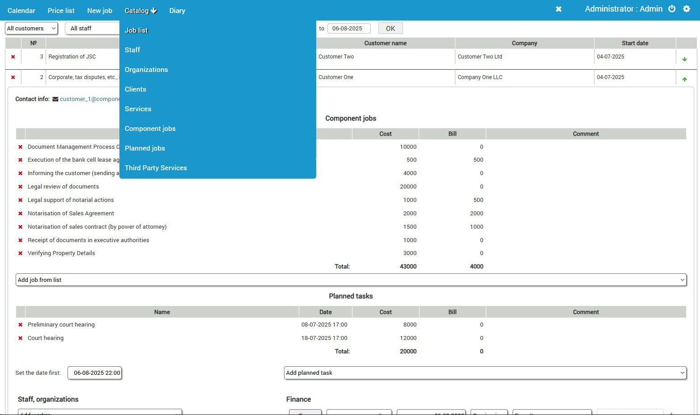
Re-assembly or adjustment of works
Current work can be adjusted/reassembled
Financial and time parameters are adjusted
Composite Tasks and Participants Change

Slide 5
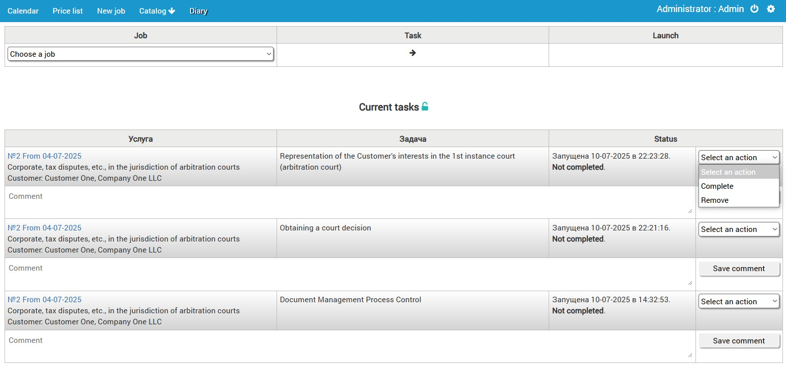
WORKFLOW AND STAFF Monitoring
A diary is attached to each task performer
Each task has the following statuses: "For execution," "Not completed" and "Completed"
In the diary, the worker marks the stages of the task
Diary - a powerful tool for controlling of workers and monitoring the state of work

Slide 6
INTEGRATION AND SCALABILITY
Expandability, connection of any ordered modules
Messengers and mail clients
INTEGRATION
Direct interaction or via API with any external systems
Google calendar
Change the number and properties of event triggers
Import/export to XML, JSON formats

Slide 7
CRM FEATURES
Q: Why our product?
We create a customized CRM with only the necessary functions. Up to corporate design requirements. This is the main difference from typical CRMs, to which adding additional modules is problematic and requires significant time. The Armenian language is integrated into our products. Therefore, not only all interface elements, but also the contents of the database - the names of works, organizations, etc., are executed in Armenian with UTF-8 encoding.

